Slide 1
Specializing in Local Business Training & Financing

Slide 2
What is Community Futures?
Federally Funded Non-profit
9 rural municipalities
4 Staff
10 Volunteer Directors

Slide 3
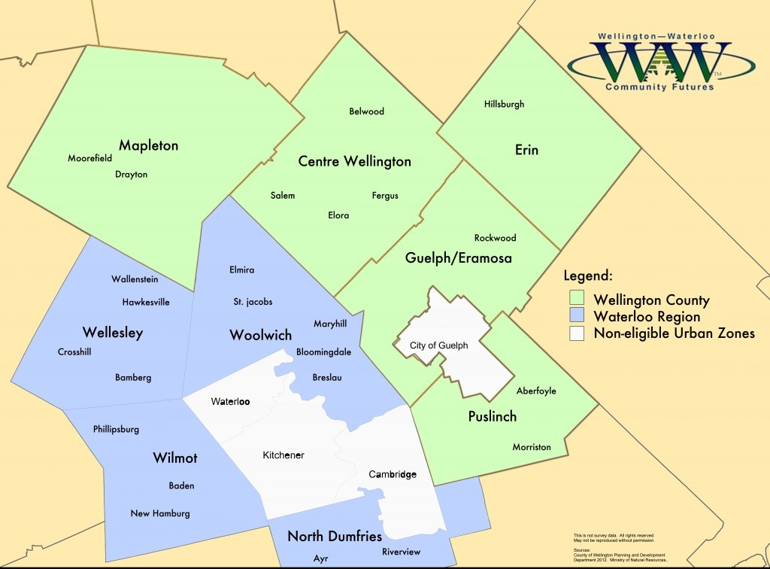

Slide 4
What do we do?
Financing
Community Economic Development
Business Support
Training
Mentoring
Coaching

Slide 5
Business Financing
The unconventional lender
Loans available up to a maximum of $300,000 Financing decisions made by board of directors
Loan Opportunities
Business Loans
Community Improvement Plan (CIP) Matching Loan Program Rural Women in Business
Futurpreneur Canada
Southern Ontario Fund for Investment and Innovation

Slide 6
WWCF Facts (to date 2023)
Total Investment
$26.9 million
Loans Advanced
489
COVID Loans Advanced
$2,747,888
Average Value of Loans
$55,010
Funds Leveraged
$45.5 million
Number of Jobs Created or Maintained
4,795
Average Loan Loss
6%
Number of Businesses Assisted
6,874

Slide 7
Business Training Workshops
Monthly training opportunities Marketing & Sales Financial Management Operations Personal Leadership Human Resources

Slide 8
Business Mentoring Program
FREE
Experienced volunteers with knowledge about running a successful business

Slide 9
Community Economic Development
We assist with:
Effective and regular communication between business, government and community groups
Properly maintained infrastructure
Access to training and development opportunities Community enthusiasm and commitment Research & Project Planning
Strategic Planning & Visioning
Facilitation
Grant Proposal Writing
Acting as a liaison between local organizations, business and representatives of government and industry

Slide 10
Stay connected!
@wwcommunityfutures
@WWCFDC
Wellington Waterloo Community Futures

Slide 11
Reach out to see how we can support your business!
Questions?

